Slide 2

The development of human-collision avoidance behavior for robotic manipulator by combine RRT and adaptive potential field algorithm
Trinh Dam Nhan – 20195802
Nguyen Van Thanh Tri - 20200634

Slide 3
Presentation Outline
Human-robot Interaction Overview
System Overview
Human Detection
RRT Algorithm
AAPF Algorithm
RRT and AAPF in Human-collision Avoidance
Conclusion

Slide 4
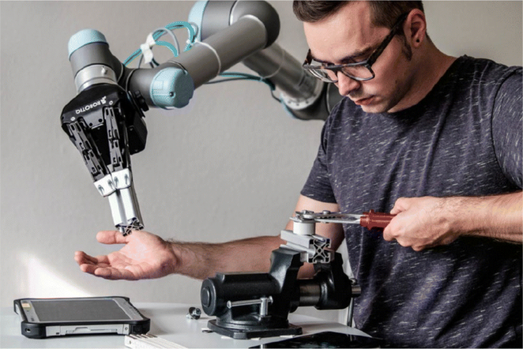
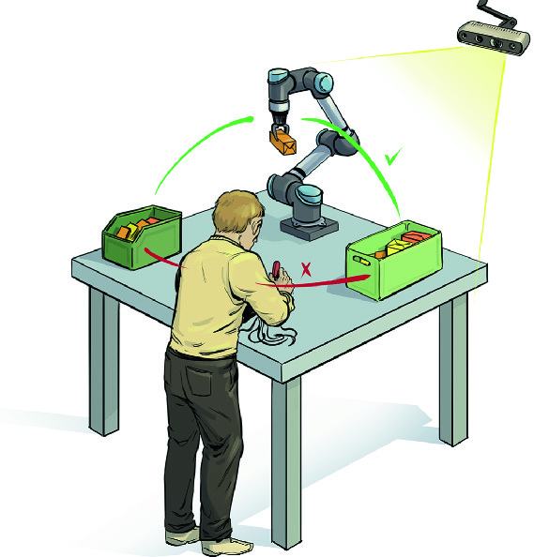
1. Human-robot Interaction Overview
Human- Robot Interaction (HRI) in Industry
HRI advantages:
Increased Efficiency, Enhance safety.
Robot flexibility and adaptability.
Social awareness and social interaction.
Notes:
Robot manipulator is the most prevalent types of robots in industry. In the new age of technology, the development of sensors and Artificial Int has given ways for more complicated and cutting-edge system. In there, Human – Robot Interaction has been a outstanding research field. We can see some example here, as robots now able to be more flexible, delicate and more aware of the environment, as it can support human in the shared workspace in assembly works (object handling, collision avoiding, human awareness). Some of the HRI advances can be clearly see here, such as more efficiency as 2 entity can work at the same workspace, more adaptability and safety. These new generations of robots that can aid human in work is called Collaborative Robot – or Cobot in short.

Slide 5
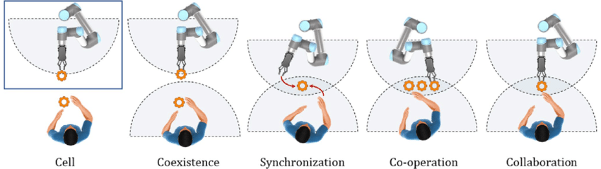
1. Human-robot Interaction Overview
1.2.Human- Robot Interaction taxonomy
Shared workspace
Needs environment and Human Awareness
Imminent danger/collision
Notes:
To understand more about HRI, researchers classified them according to their characteristics and cognitive abilities. “Cell” is where there are none interaction happens between two subjects; “Co-existance” and “Sync” is 2 subjects shared a physical workspace, though there are little interactions since their work doesn’t occur simultaneously. “Cooperation” and “Collaboration” are where HRI appears the most, since the 2 subjects often work together or there are plenty of interactions between. In these cases, robot needs to have a flexible and high-spatial awareness, have the ability to avoid collision with human worker.

Slide 6
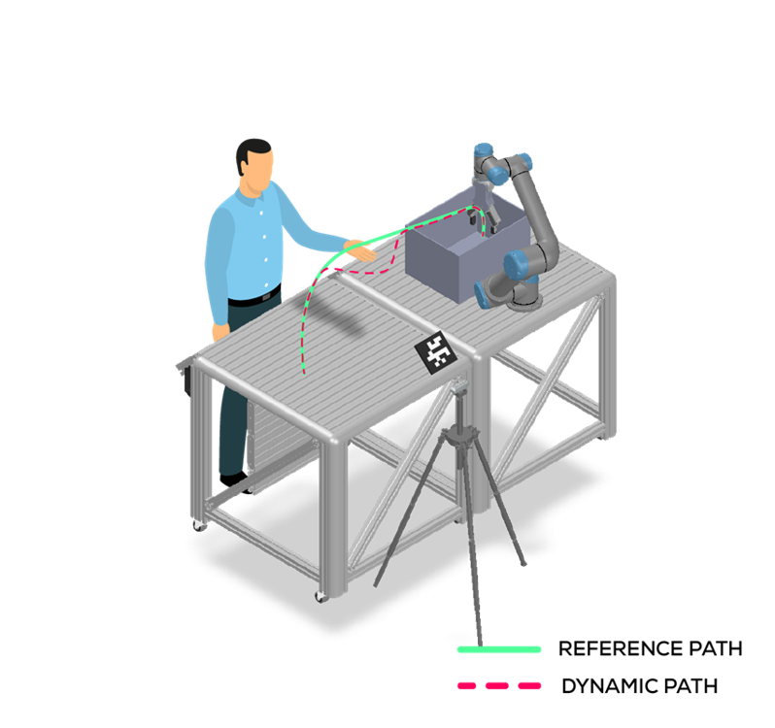
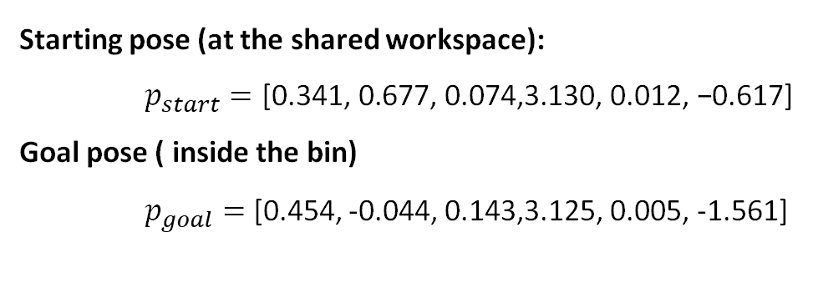
1. Human-robot Interaction Overview
Our project goals are:
Implementing a human-avoiding behaviors on UR5 robot.
Proposing a new hybrid path planner suitable for the experiment to avoid human collision.
Implementing image processing with the help of AI model to detect and calculate human position.
End Point
Starting pose (at the shared workspace):
$p_{start}=\text{[0.341, 0.677, 0.074,3.130, 0.012, −0.617]}$
Goal pose ( inside the bin)
$p_{goal}=$ [0.454, -0.044, 0.143,3.125, 0.005, -1.561]
Start Point
Notes:
With that being said, our goals will focus on research and deploying the HRI on a Cobot in human shared workspace The goal of our project is implementing human – avoiding behaviors for the UR5 robot, proposed a hybrid path planner for our experiments scenario, using img processing techniques to detect and calculate the human position.
Our test case is to move a robot from two pose in Cartesian coordinates, creates a reference path in a form of a waypoints set, then create and execute the dynamic path taking into account the possibility of human hand’s appearance. We only choose a body part – human wrist to test as it doesn’t take away the generality of the method, as well as the system can be scaled to take into account the whole body.

Slide 7
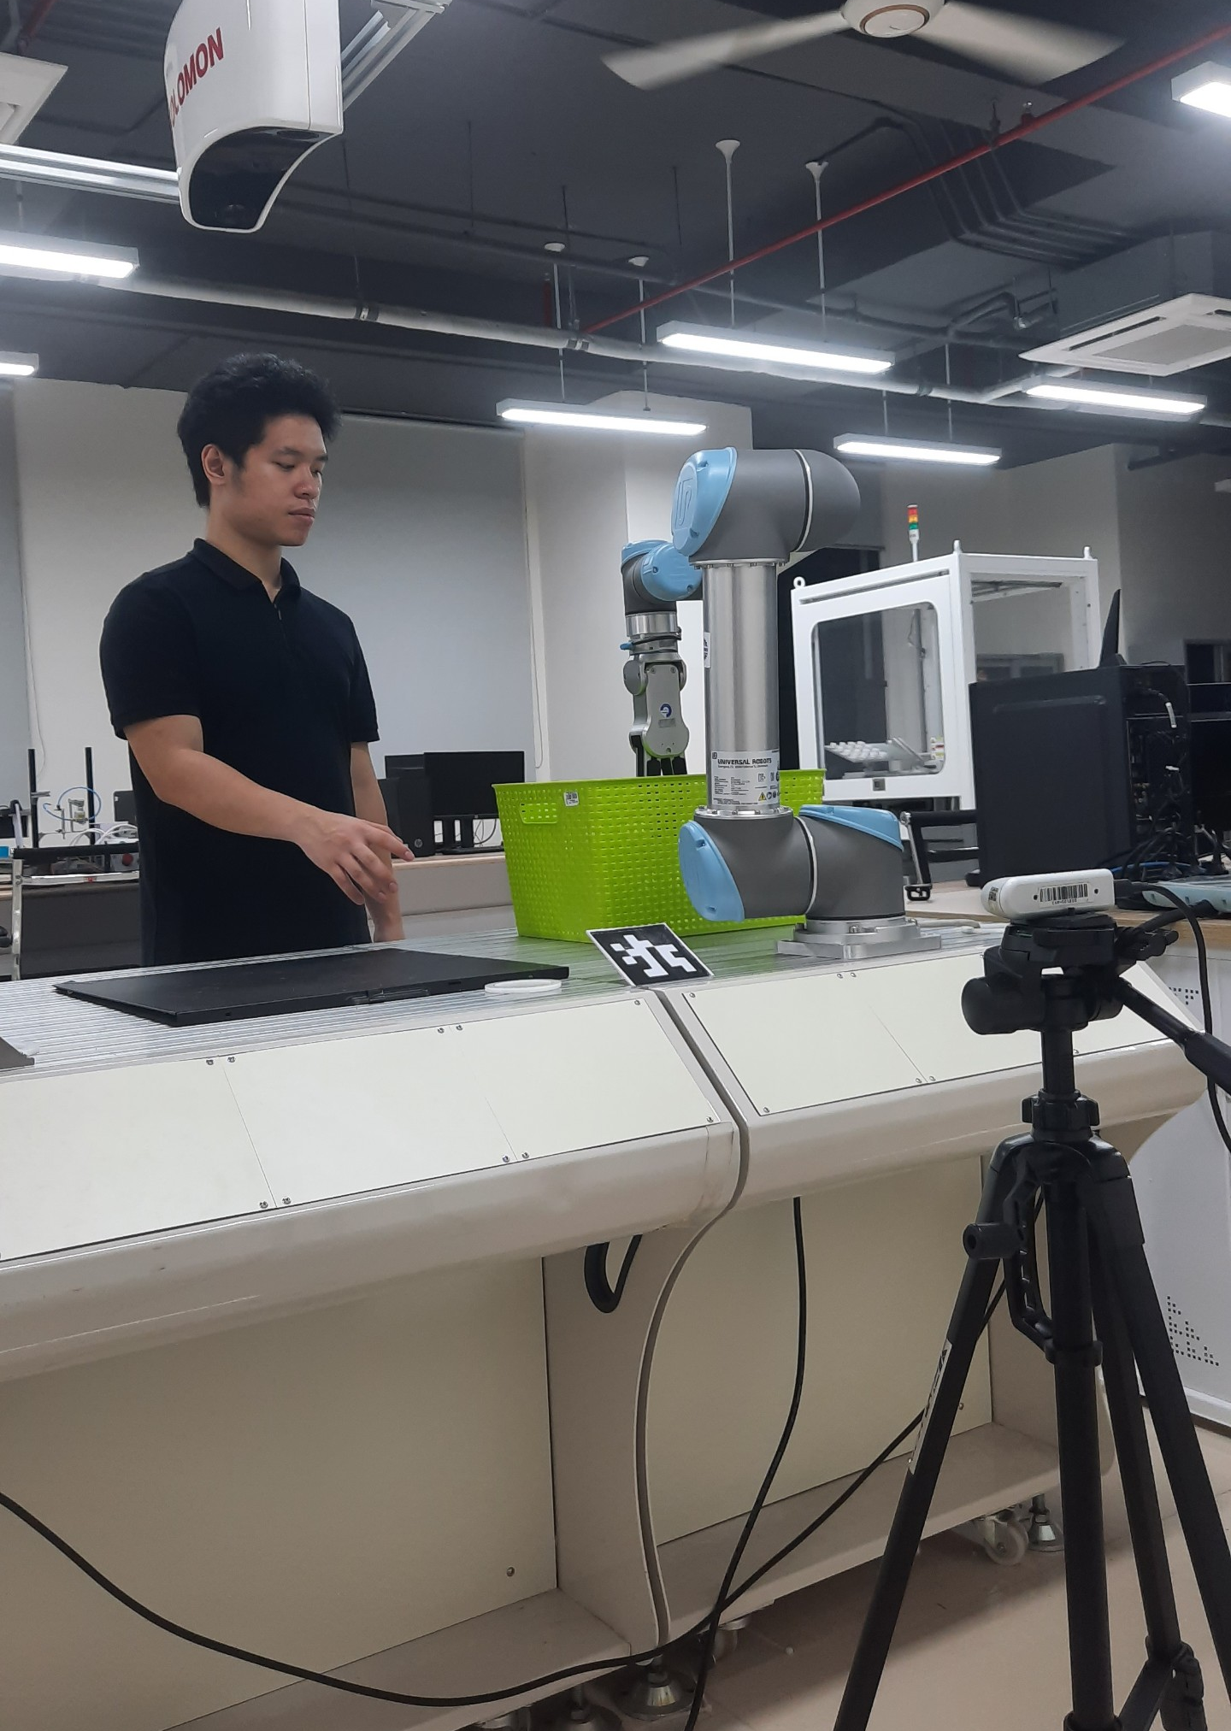
2. System Overview
Experiment scenario information:
Known Obstacle: Basket
Unknown Obstacle: Human
Global Planner: RRT
Local Planner: AAPF (Adaptive Artificial Potential Field)
UR5 Robot
Human
Camera D435
Basket
Notes:
Our experiment scenario can be seen in the picture, with the basket and the table are the known static obstacles in Planning Scene. Our human is the unknown obstacle. We proposed a hybrid planner, forms of a global planner using RRT and a local planner using AAPF.

Slide 8
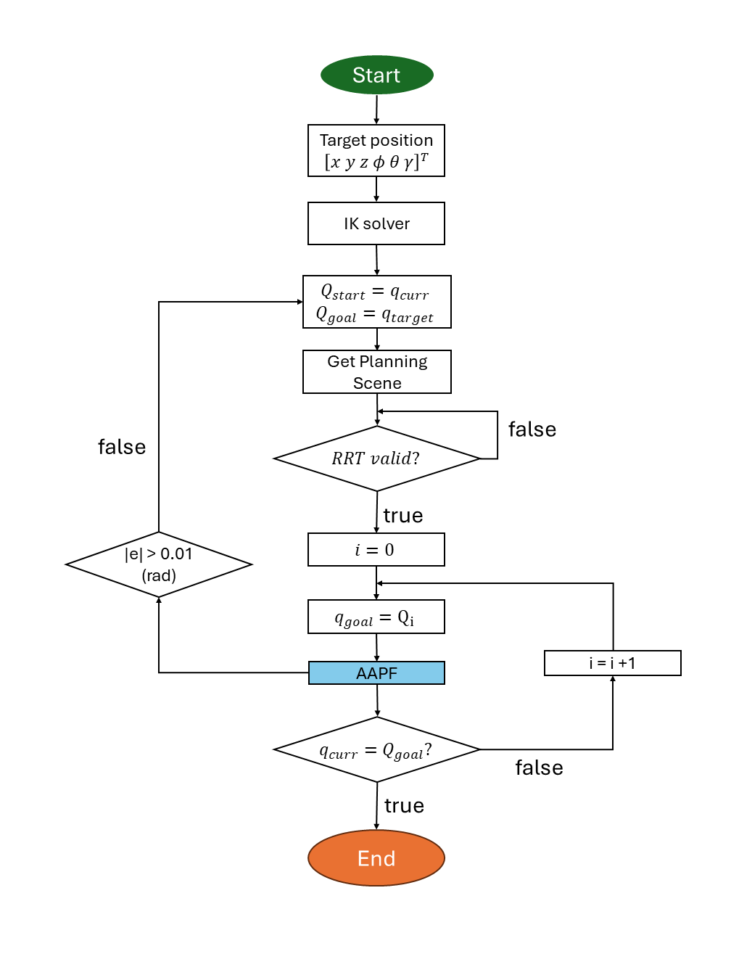
3. Human Detection
Get Planning Scene

Slide 9
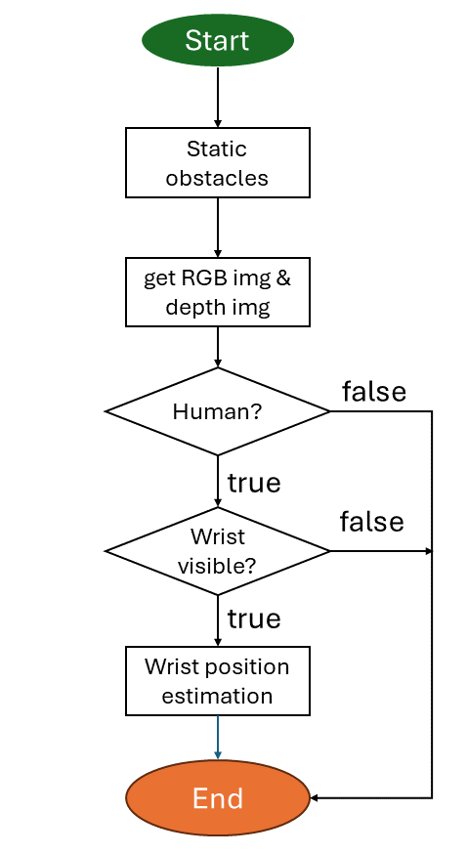
3. Human Detection
3.1. Get Planning Scene block
Take RGB & Depth
Checking Human?
Checking Wrist?
Calculate Wrist position.
Get Planning Scene
Notes:
We will go into discussion of the Human detection module. Our pipeline is work as follow, the camera will take the RGB and Depth images, then proceed to check if there’s human in the view by calling the AI model. If there is a human worker, we will continue to check for right wrist of the human. If the wrist is visible, the wrist position is to be estimated by image processing process. When the flowchart end, the get Planning Scene will update.
The average duration for a loop of this block when running on our computer is 0.57s. ➔ if more than 25s has passed, will replan RRT (in the following chap)

Slide 10
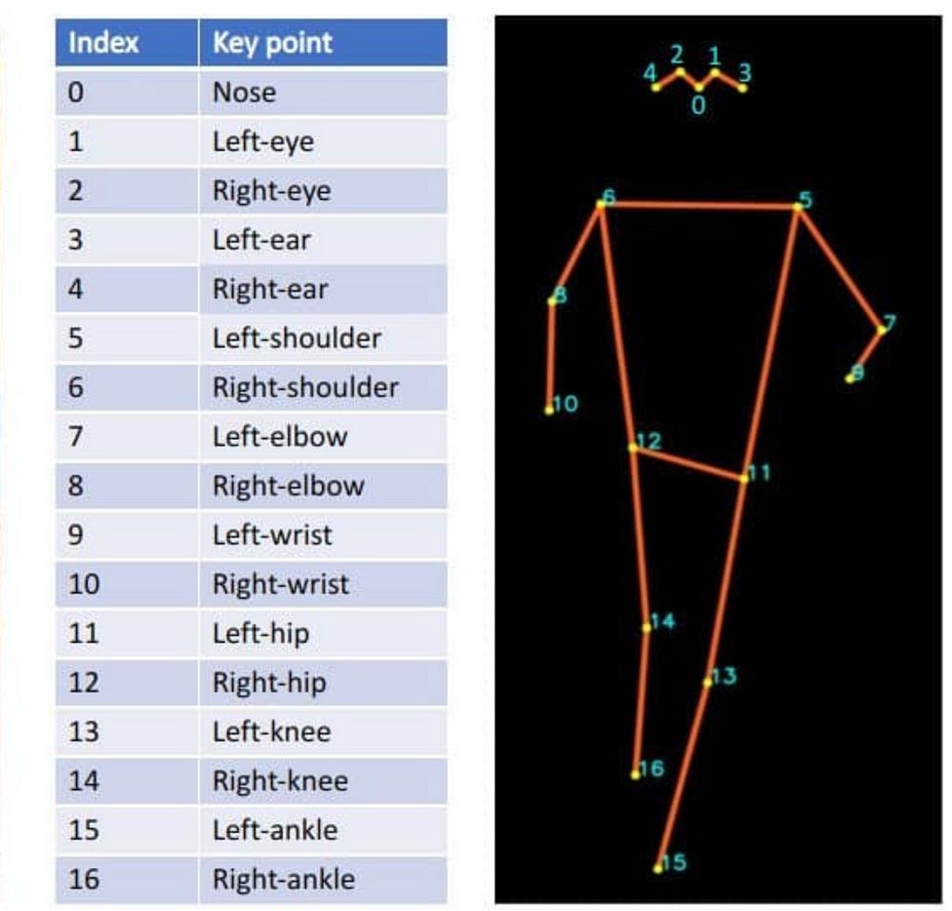
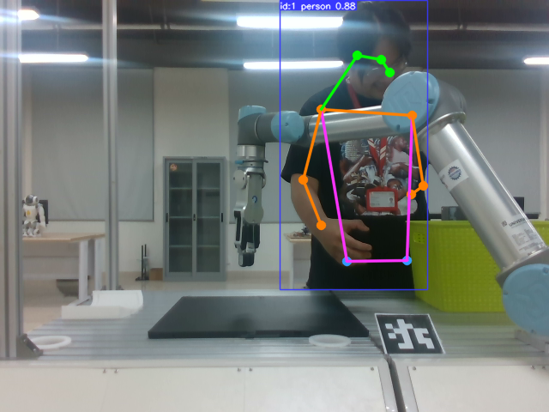
3. Human Detection
Human is detected by YOLOv8 pre-trained Model ( trained with COCO dataset).
COCO dataset human keypoints annotation
Human detection
Notes:
We use the YOLOv8 model for detecting our human poses and keypoints. Keypoints are points represent a human bodyparts, annotated in the data for training purpose. The model is YOLOv8n-pose, specialized to detect human keypoints, and it was pretrained on the Microsoft COCO dataset - Common Object in Context. From then, we will extracting the position of the right-wrist of our human to calculate it’s real position.

Slide 11


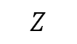
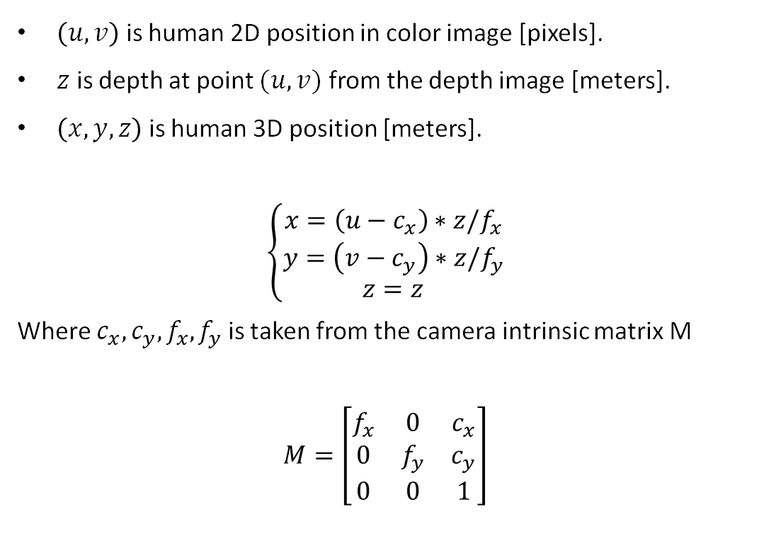
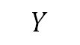
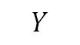
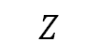
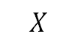
3. Human Detection
3.2. Estimate human wrist position.
$\left(u,v\right)$ is human 2D position in color image [pixels].
$z$ is depth at point $(u,v)$ from the depth image [meters].
$\left(x,y,z\right)$ is human 3D position [meters].
$$\left\{\begin{aligned}x=\left(u−c_{x}\right)∗z/f_{x} \\ y=\left(v−c_{y}\right)∗z/f_{y} \\ z=z\end{aligned}\right.$$
Where $c_{x}, c_{y},f_{x},f_{y}$ is taken from the camera intrinsic matrix M
$$M=\left[\begin{matrix}f_{x} & 0 & c_{x} \\ 0 & f_{y} & c_{y} \\ 0 & 0 & 1\end{matrix}\right]$$
Human Hand
$$Z$$
Aruco Frame
$$Y$$
$$Z$$
$$Z$$
$$X$$
Robot Frame
Camera Frame
$$Y$$
$$Y$$
$$X$$
$$X$$
Notes:
From YOLOv8 result we can get the hand position on the image plane, and from the depth image we can extract the human hand position in the 3D space. To transform u,v to 3D position, we need to do some coordinate transform from the camera coordinates to the base coordinates (robot coordinates), and done some calculate its position. The coordinates conversion matrix can be obtained by using Aruco Marker, while (x,y,z) of human hand in the camera coordinates can be calculated as above.
Cx, cy are pixel deviation from the centerpoint of the image to the x and y axis. Fx, fy are focal length in pixel.

Slide 12
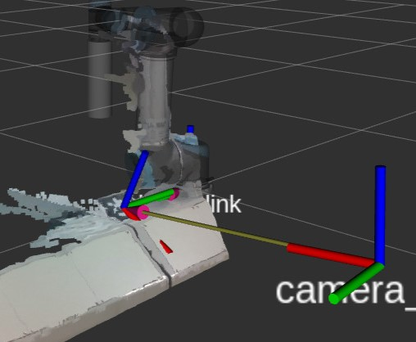
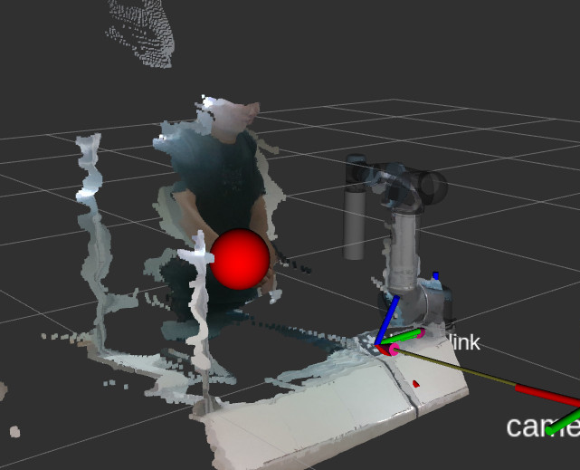
3. Human Detection
3.2. Estimate wrist position
Aruco Marker – Camera coordinates
Sphere position in Planning Scene
Notes:
1st pic: Camera – Aruco transformation matrix. Since Aruco mark position is known from the robot base coordinate, we can calculate camera – robot transformation matrix.
2nd pic: After obtain the wrist position in the base coordinates, we creates a sphere represent its position as the obstacle in the planning scene.
The two images above are visualized in pointcloud

Slide 13
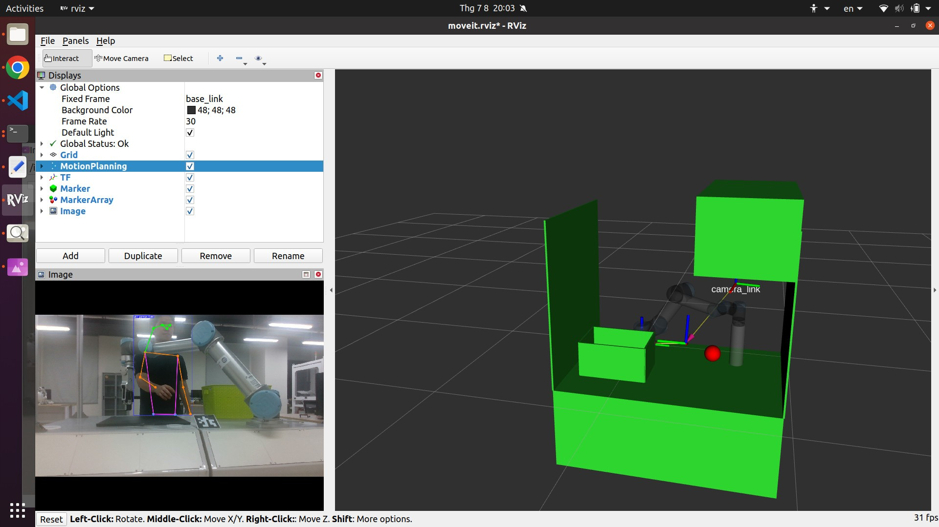
3. Human Detection
The position of human wrist is sent to the planning scene in AAPF Planner as a red sphere with d=0.218m
Camera view
RVIZ view
Notes:
Static obstacle: Màu xanh lá cây.Tay được biểu thị bằng quả cầu màu đỏ.
The human wrist position is sent to the planning scene in our planner as a red sphere with the diameter of 0.218m as it is the average size of male hand according to NASA research in 2005. The static obstacles are represented as green blocks (table, Solomon camera, basket…) to create the complexity, where the red sphere is the human wrist position.

Slide 14
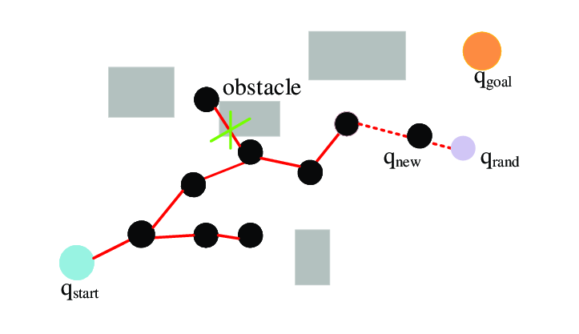
4. RRT Algorithm
RRT (Rapidly exploring random tree) is a sampling-based algorithm use for path planning in robotics.
Advantages:
Handles high-dimensional configuration.
Deals with complex obstacles and constraints.
Low time complexity compared to A* and Dijkstra's algorithm.
Notes:
One of the most well known alg for manipulator path planning is RRT. It’s a sampling-based alg, the idea behind it is creating random nodes in the environment and try to connect it to the goal to create a tree. This tree is continuously built by random sampling, ensuring it always expands into unexplored regions of the space The advantage of RRT is that it can handle high dim configurations, very suitable for planning manipulators. It can also take in to account complex obstacles and contrains that we give the planning scene. And since its not a brute force complete search as A* or Dijkstra, RRT has lower complexity.

Slide 15
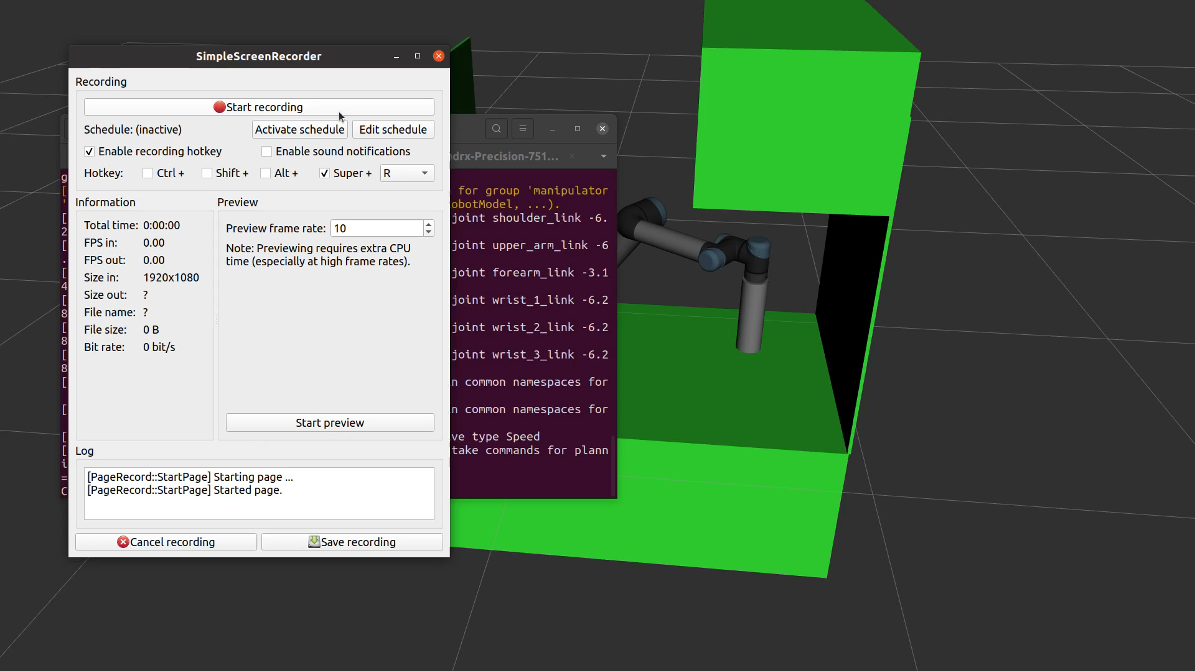
4. RRT Algorithm
RRT in experimenting scenario:
Notes:
Smooth trajectory.
The distance between robot and obstacles is narrow.
Not suitable in dynamic environments due to long replan time.
Robot executing RRT path
Notes:
In this video, we try use RRT to plan the path in our experimental case. We can see that RRT path can be execute smoothly and rather fast, but we can see that there are area that the path and the obstacle (basket) is very narrow, and if there is a unknown obstacle appear in the scene, the replan time using RRT is considerably long.

Slide 16
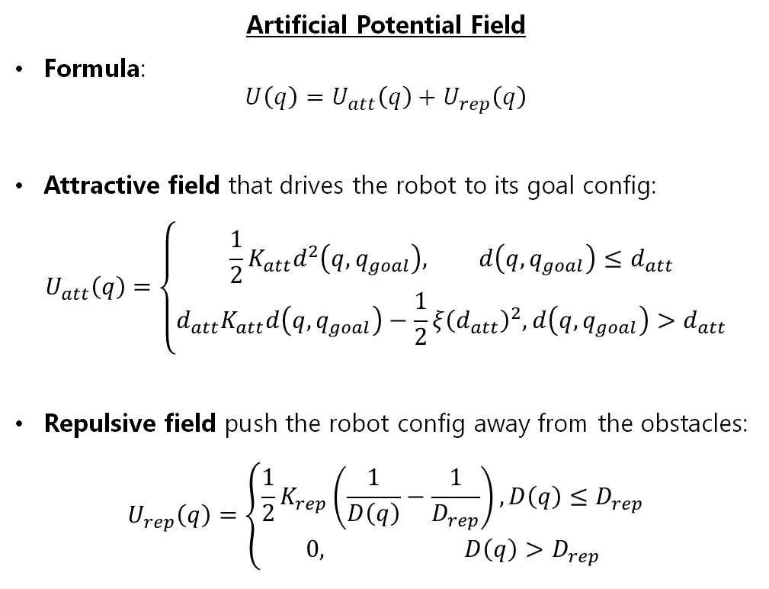
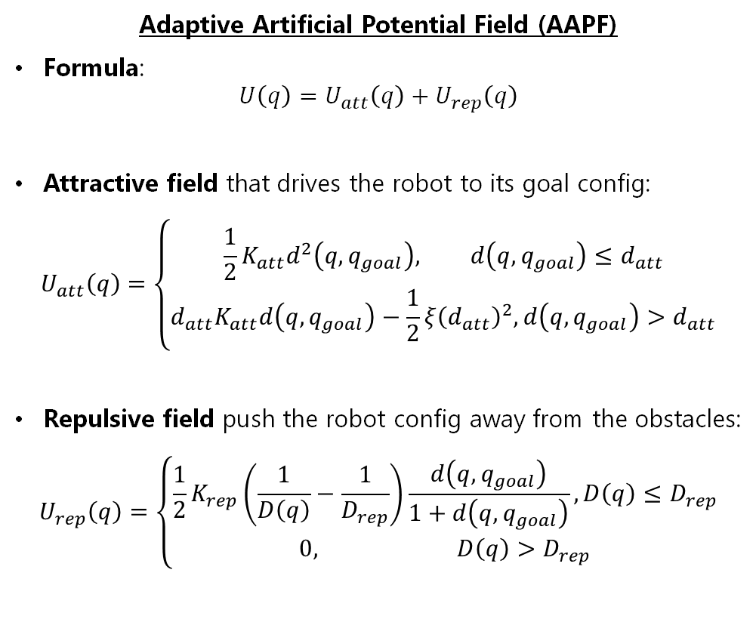
5. AAPF Algorithm
Artificial Potential Field
Formula:
$$U\left(q\right)=U_{att}\left(q\right)+U_{rep}\left(q\right)$$
Attractive field that drives the robot to its goal config:
$$U_{att}\left(q\right)=\left\{\begin{aligned}\frac{1}{2}K_{att}d^{2}\left(q,q_{goal}\right), d\left(q,q_{goal}\right)≤d_{att} \\ d_{att}K_{att}d\left(q,q_{goal}\right)−\frac{1}{2}ξ{\left(d_{att}\right)}^{2}, d\left(q,q_{goal}\right)>d_{att}\end{aligned}\right.$$
Repulsive field push the robot config away from the obstacles:
$$U_{rep}\left(q\right)=\left\{\begin{aligned}\frac{1}{2}K_{rep}\left(\frac{1}{D\left(q\right)}−\frac{1}{D_{rep}}\right), D\left(q\right)≤D_{rep} \\ 0, D\left(q\right)>D_{rep}\end{aligned}\right.$$
Adaptive Artificial Potential Field (AAPF)
Formula:
$$U\left(q\right)=U_{att}\left(q\right)+U_{rep}\left(q\right)$$
Attractive field that drives the robot to its goal config:
$$U_{att}\left(q\right)=\left\{\begin{aligned}\frac{1}{2}K_{att}d^{2}\left(q,q_{goal}\right), d\left(q,q_{goal}\right)≤d_{att} \\ {d_{att}K}_{att}d\left(q,q_{goal}\right)−\frac{1}{2}ξ{\left(d_{att}\right)}^{2}, d\left(q,q_{goal}\right)>d_{att}\end{aligned}\right.$$
Repulsive field push the robot config away from the obstacles:
$$U_{rep}\left(q\right)=\left\{\begin{aligned}\frac{1}{2}K_{rep}\left(\frac{1}{D\left(q\right)}−\frac{1}{D_{rep}}\right)\frac{d\left(q,q_{goal}\right)}{1+d\left(q,q_{goal}\right)}, D\left(q\right)≤D_{rep} \\ 0, D\left(q\right)>D_{rep}\end{aligned}\right.$$
Notes:
The AAPF is based on the theory of Artificial Potential Field. By assigning a attractive field to the goal, repulsive fields to obstacle, the robot path can be achieved by guiding the robot to the goal through the sum of these fields. In the project, we utilize the Adaptive version of APF, since its repulsive can adjust its value due to the relative position between the robot and the obstacle.
The attractive field formula stays unchanged, and it is comprised of the “conic well” and the “parabolic well”.
D_rep is the repulsive field influence range, where d_att is the threshold of att field to switch between conic and parabolic form

Slide 17
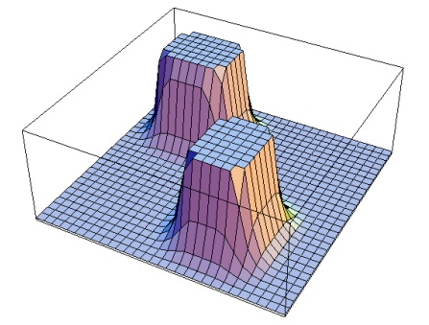
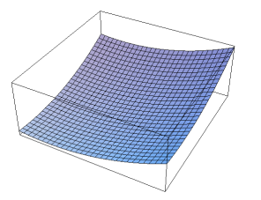
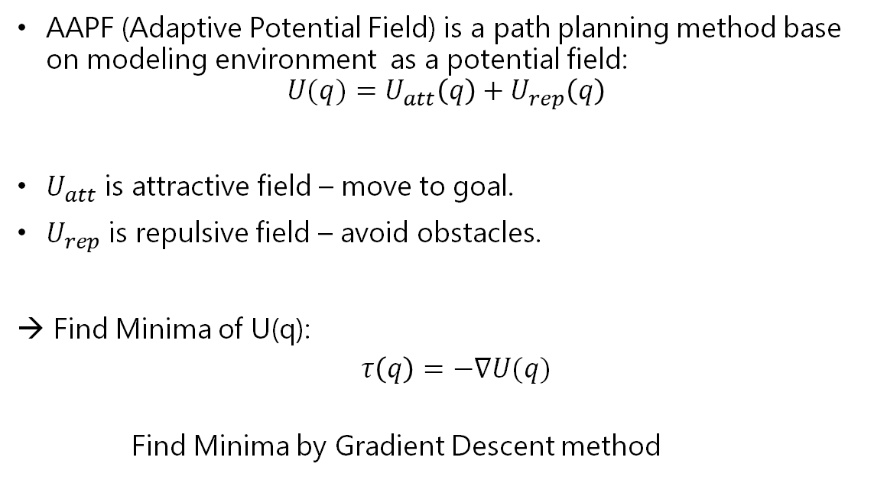
5. AAPF Algorithm
AAPF (Adaptive Potential Field) is a path planning method base on modeling environment as a potential field:
$$U(q)=U_{att}\left(q\right)+U_{rep}\left(q\right)$$
$U_{att}$ is attractive field – move to goal.
$U_{rep}$ is repulsive field – avoid obstacles.
Find Minima of U(q):
$τ\left(q\right)=−∇U(q)$
Find Minima by Gradient Descent method
Attractive field
Repulsive field
Notes:
Since we are planning path for the manipulator, the potential field and torques are represented in the joint space (q). The goal and start are the joint configuration.
To find the torques applied to the robot config, we defined the control points – the points of the robot config that these forces field affects and calculate the forces by taking the gradient of the potential field. The goal position/config is usually the minimum of of the field, so that we need to find the this point by Gradient Descent method.
This can be applied to the forces/torques formula, where the minimum should be at the goal since it created the highest attractive forces.

Slide 18
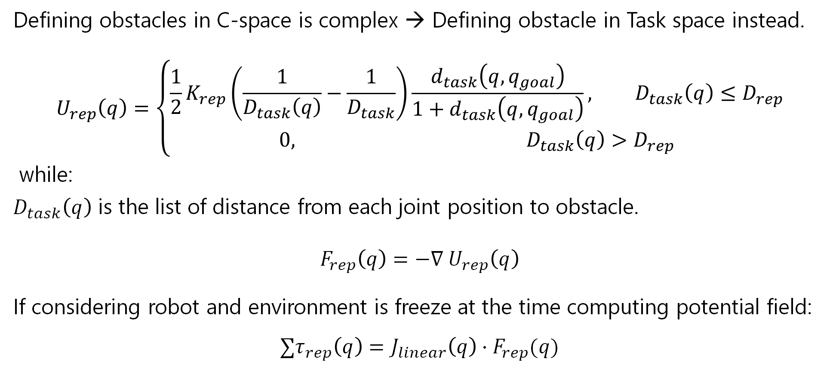
5. AAPF Algorithm
Defining obstacles in C-space is complex → Defining obstacle in Task space instead.
$$U_{rep}\left(q\right)=\left\{\begin{aligned}\frac{1}{2}K_{rep}\left(\frac{1}{D_{task}\left(q\right)}−\frac{1}{D_{task}}\right)\frac{d_{task}\left(q,q_{goal}\right)}{1+d_{task}\left(q,q_{goal}\right)}, D_{task}\left(q\right)≤D_{rep} \\ 0, D_{task}\left(q\right)>D_{rep}\end{aligned}\right.$$
while:
$D_{task}\left(q\right)$ is the list of distance from each joint position to obstacle.
$$F_{rep}\left(q\right)=−∇ U_{rep}\left(q\right)$$
If considering robot and environment is freeze at the time computing potential field:
$${∑τ}_{rep}\left(q\right)=J_{linear}\left(q\right)⋅F_{rep}(q)$$
Notes:
The repulsive fields are particularly hard to calculate in joint space, since its formula contains the distance between the robot and the obstacle, and this distance is very hard to describe in joint space. Because of that, we calculate the the rep field in task space, and consequently convert the forces in task space to joint space torques.
Because the rep forces in task space are applied on set of control points, we only need to multiply with the linear parts of the Jacobian matrix.

Slide 19
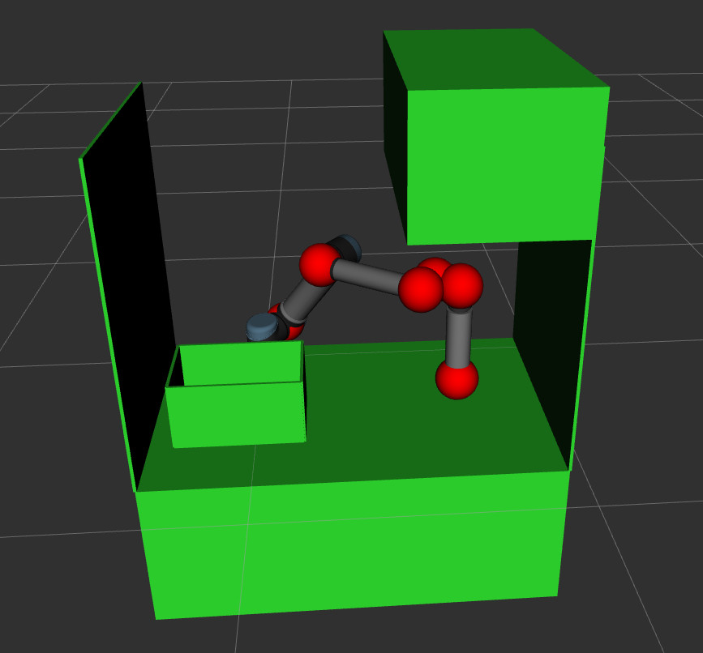
5. AAPF Algorithm
There are 6 control points:
Joint 2 to joint 6.
The end-effector.
Control points visualization
Notes:
Since the repulsive forces are calculated in task space, we choose a set of control points on the robot configuration to be the force applying points. For the purpose of simplicity, we choose the joints as the control points.

Slide 20
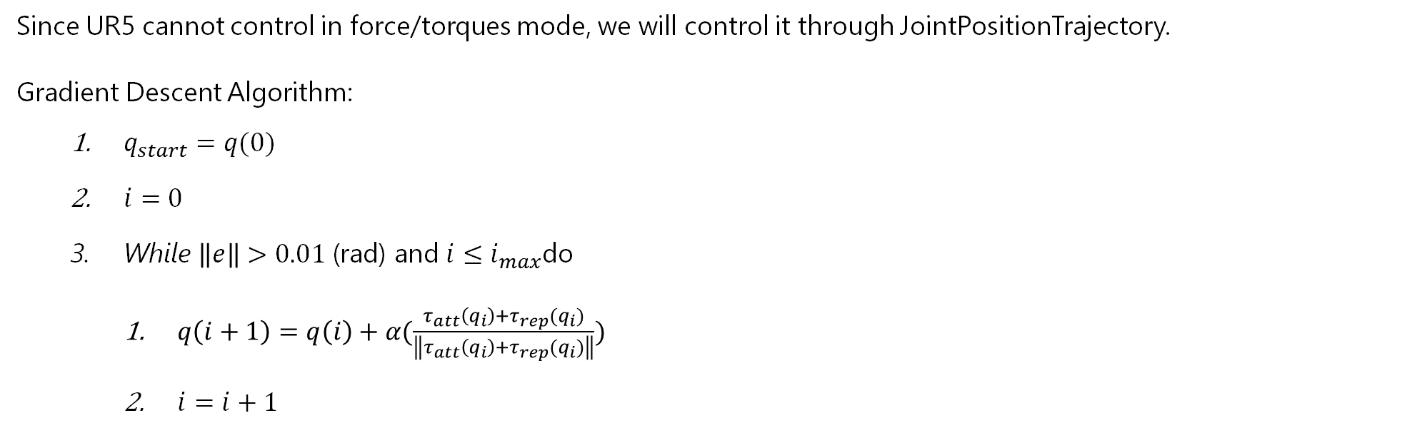
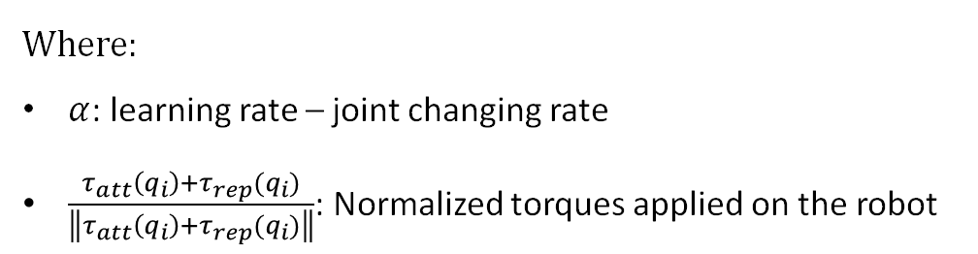
5. AAPF Algorithm
Since UR5 cannot control in force/torques mode, we will control it through JointPositionTrajectory.
Gradient Descent Algorithm:
$q_{start}=q(0)$
$i=0$
While $\left\|e\right\|>0.01$ (rad) and $i≤i_{max}$do
$q\left(i+1\right)=q\left(i\right)+α(\frac{τ_{att}\left(q_{i}\right)+τ_{rep}(q_{i})}{\left\|τ_{att}\left(q_{i}\right)+τ_{rep}(q_{i})\right\|})$
$i=i+1$
Where:
$α$: learning rate – joint changing rate
$\frac{τ_{att}\left(q_{i}\right)+τ_{rep}(q_{i})}{\left\|τ_{att}\left(q_{i}\right)+τ_{rep}(q_{i})\right\|}$: Normalized torques applied on the robot
Notes:
The UR5 control interface are only velocity or trajectory, we will control the robot through JointPositionTrajectory. Based on the direction of the vector force we yield from the fields, we can step by step move the config to the goal in that direction by Gradient Descent.
With alpha is the learning rate – in this case is also the step of changing in joint position (rad). We normalize the torques since only its direction matters.

Slide 21
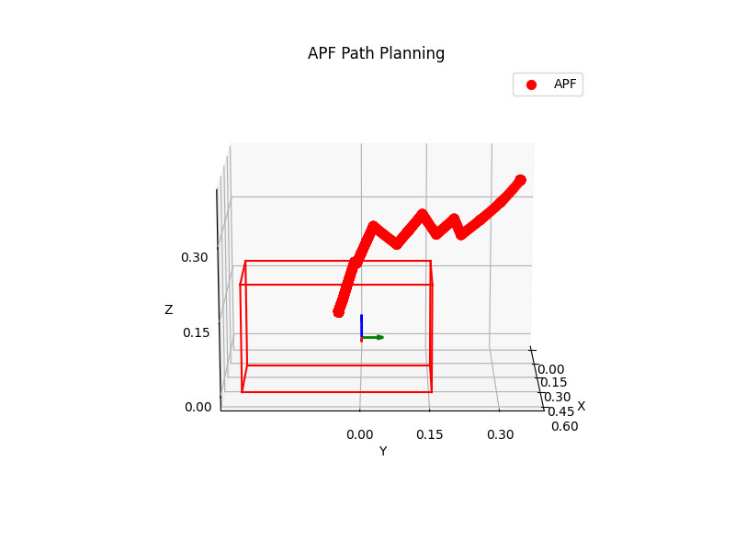
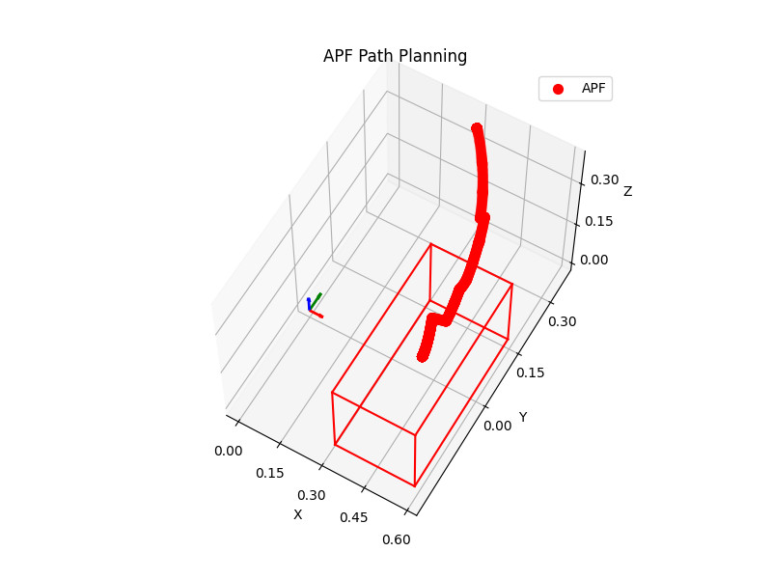
5. AAPF Algorithm
AAPF only works in certain scenario:
Notes:
Different starting pose.
Shaky, spiky path.
Notes:
By applying AAPF, the planned path is very shaky and spiky due to the forces differences between calculations when under the repulsive fields influence. Furthermore, this only works in the scenario where the starting pose has a relatively clear toward the goal pose.

Slide 22
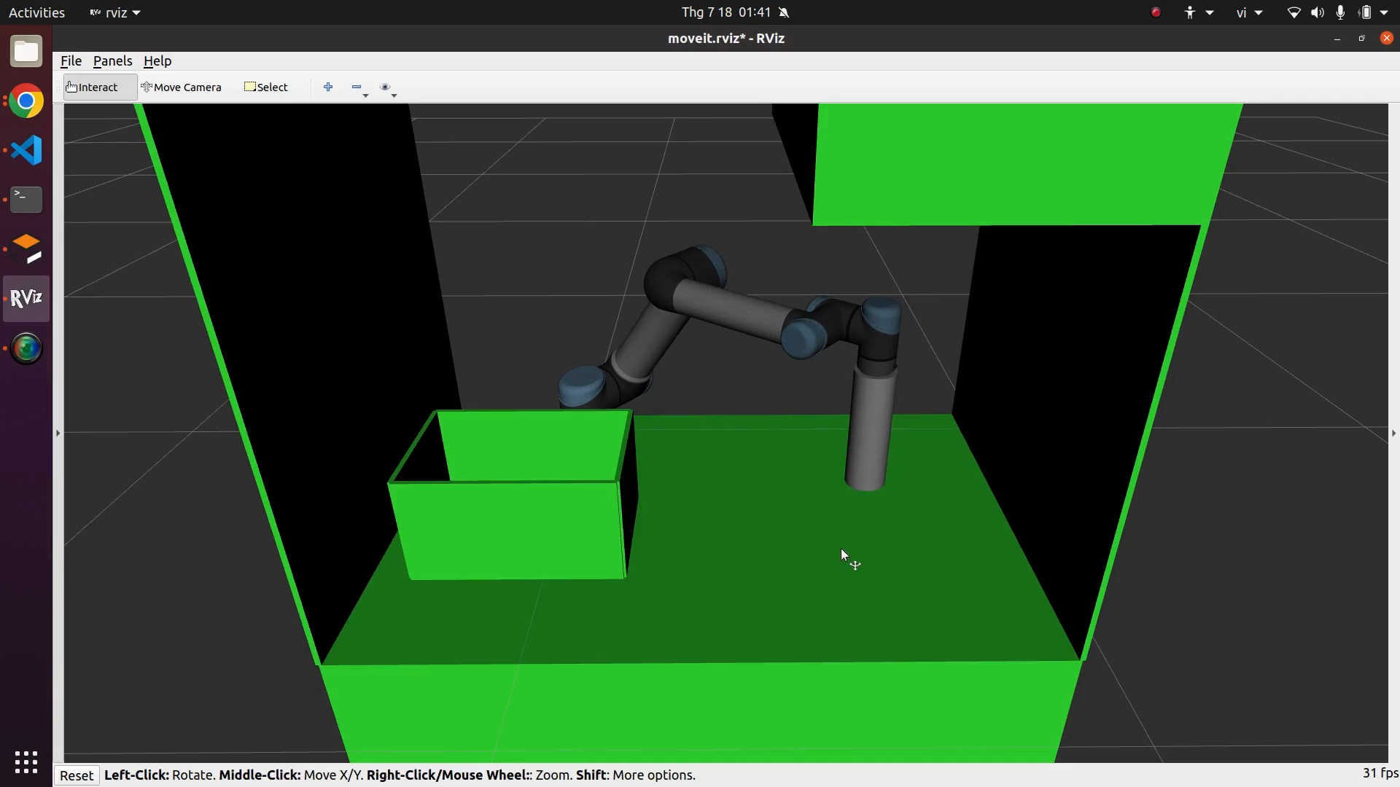
5. AAPF Algorithm
AAPF in experimenting scenario:
Notes:
Can be applied in Dynamic Environments.
The path generated is jerky, shaky.
Robot is locked in Local Minima
Notes:
As of in our experimenting case, the goal cannot be reached because the robot is locked in the local minima – the position where the repulsive forces and the attractive force equalize each other.

Slide 23
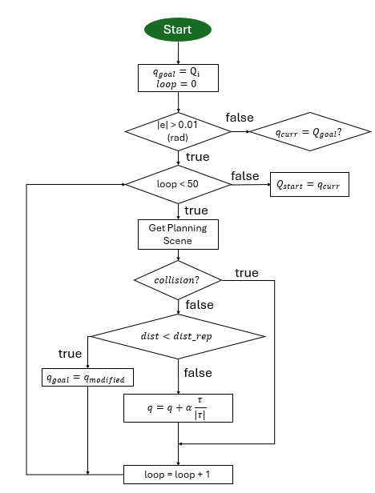
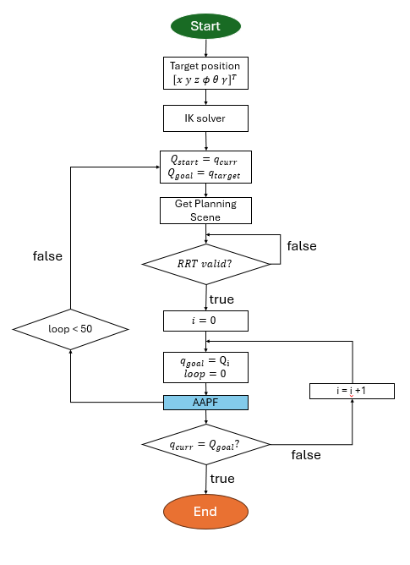
6. RRT and AAPF in Human-collision avoidance
AAPF
Notes:
Our planner is a hybrid one, consist of global planner RRT block to generate a reference path to guide the robot. The starting and goal pose will first put through an ik solver to get the start and goal config, and then the RRT will give out a set of reference waypoint. Then, 2 consecutive config will be sent to the local planner AAPF block. The AAPF will plan the path between these 2 configs, and avoid the unknown human if they are detected in the scene. In the case of local minima or human collision, the AAPF block will wait 50 loops ~ 25s, if in the meantime the conditions are not met, we will replan the reference path using RRT.
As of the AAPF planner, its human avoiding behaviors can be explained in 3 cases.

Slide 24
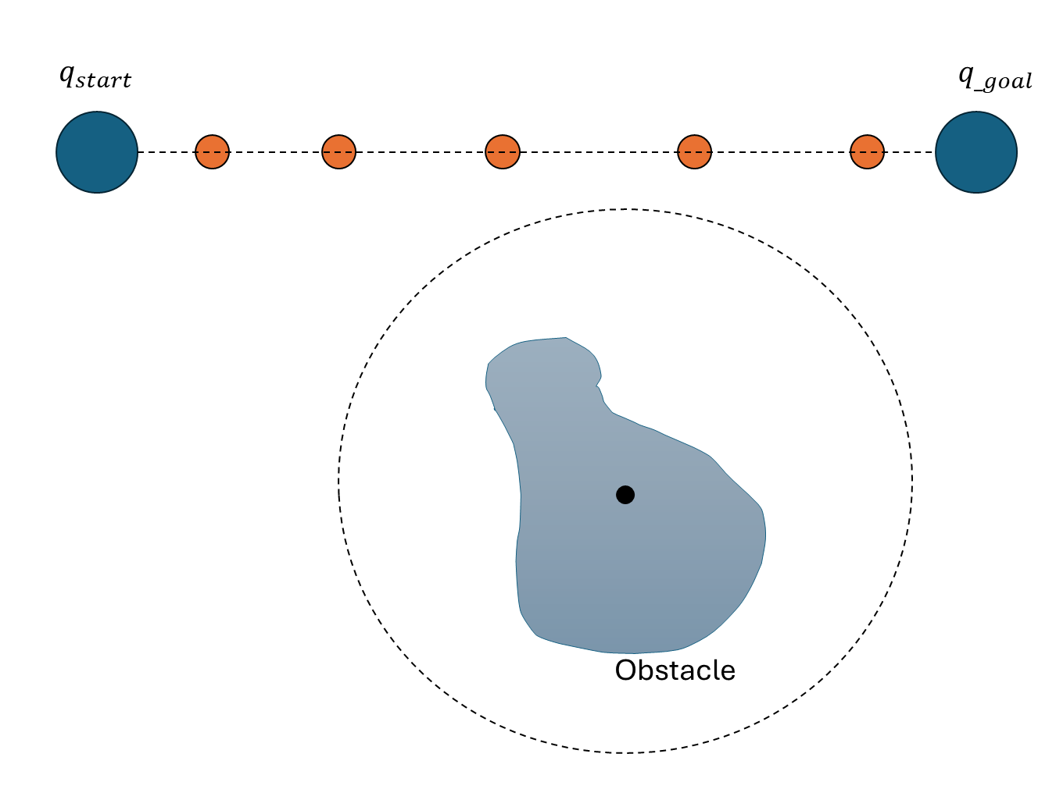
6. RRT and AAPF in Human-collision avoidance
6.1. AAPF human cases.
Out of range: $dist>dist_{rep}$. The AAPF planning happens as usual.
Reference point fed
Into AAPF
Waypoints AAPF
Obstacle
Simplified repulsive
field
Notes:
The 1st case: the human hand appears but the goal is outside of the repulsive field’s range. In this case, the AAPF will plan the path as if there are no wrist detected. The sum forces applied on the robot will be the attractive field and the repulsive field.

Slide 25
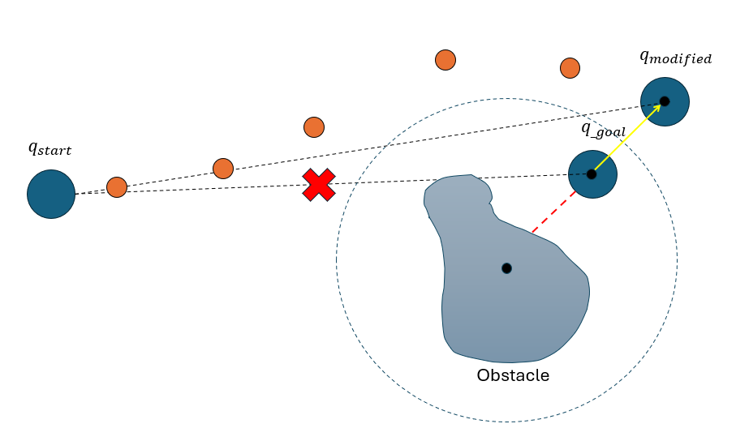
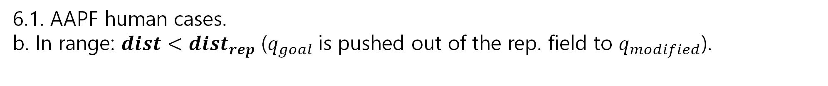
6. RRT and AAPF in Human-collision avoidance
6.1. AAPF human cases.
b. In range: $dist<dist_{rep}$ ($q_{goal}$is pushed out of the rep. field to $q_{modified}$).
Reference point fed
Into AAPF
Waypoints AAPF
Obstacle
Simplified repulsive
field
Notes:
2nd case: the goal config is in range of the obstacle repulsive field . This will likely to result in the jerky and shaky shapes of the path, because as the config gets closer to the goal, the attractive force will become smaller and the repulsive from the obstacle will become bigger. To overcome this problem, we will replan the goal config of the local planner, by taking the direction of the repulsive force and move the goal config along this vector, until the new goal has escaped the influence of the rep field. After that, the AAPF will plan from q_start to q_mod

Slide 26
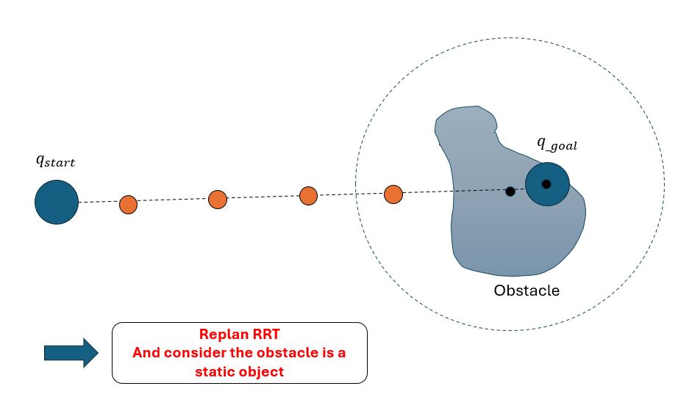
6. RRT and AAPF in Human-collision avoidance
6.1. AAPF human cases.
c. Collision: replan using RRT for new reference waypoints.
Reference point fed
Into AAPF
Waypoints AAPF
Obstacle
Simplified repulsive
field
Notes:
3rd : The human hand is in occluding the reference waypoint from RRT. This will result in the AAPF path will never reach the goal config, and collision with human is likely to happen. To overcome this, we make the robot stop to check whether if the human hand will stay at the reference point or will move to another position. If the the loops reach 50, which means the robot has stopped for 25s, the planner will take the robot’s current config as its global starting config and its original goal config to replan using RRT, considering the hand position as a static sphere obstacle. The RRT will give out a new set of reference path considering the new planning scene with the static sphere.

Slide 27
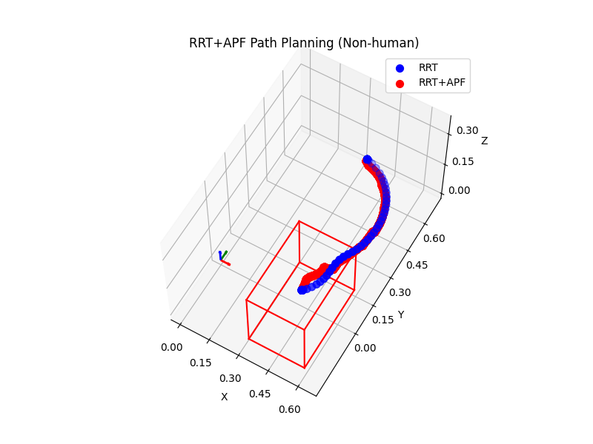
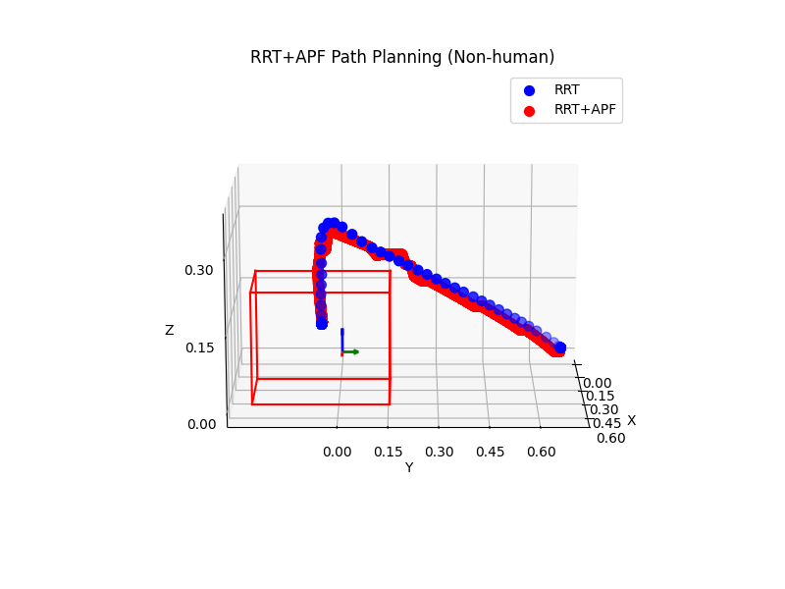
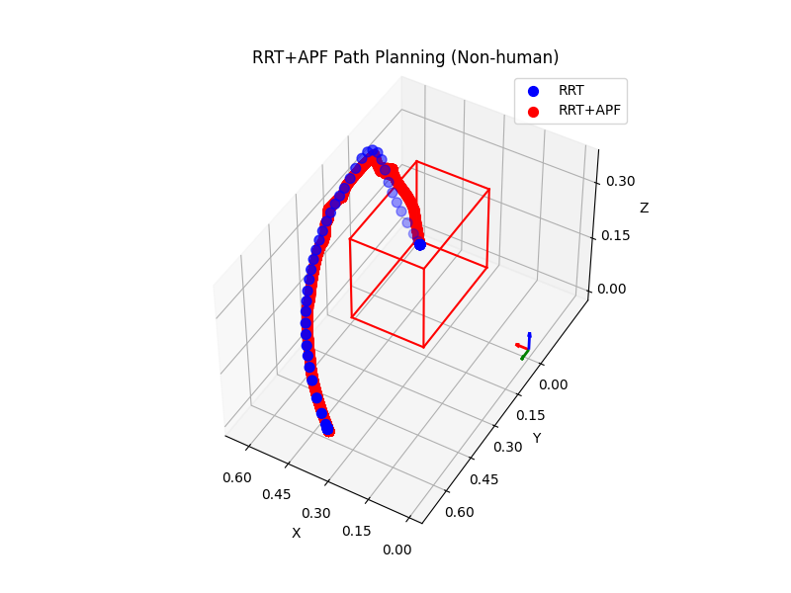
6. RRT and AAPF in Human-collision avoidance
6.2.RRT and AAPF with non-human scenario:
Robot Trajectory with out human hand appearance
Notes:
Results of the reference path and planned path when no human wrist detected.

Slide 28
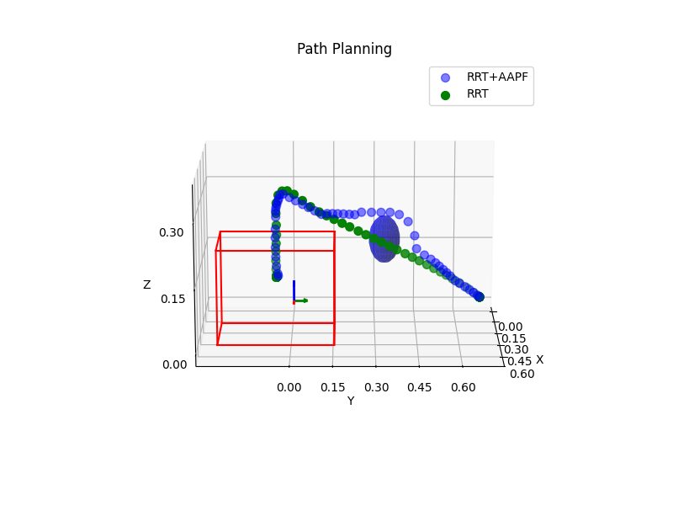
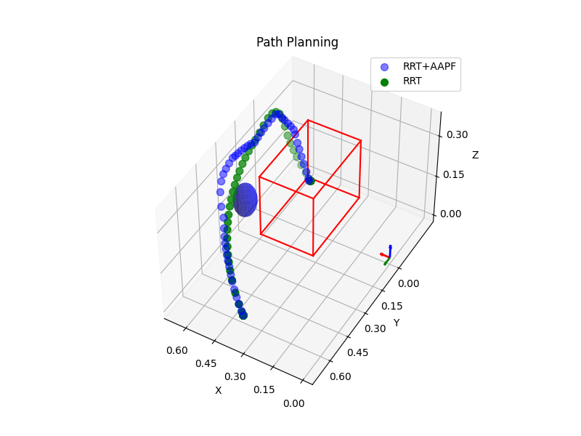
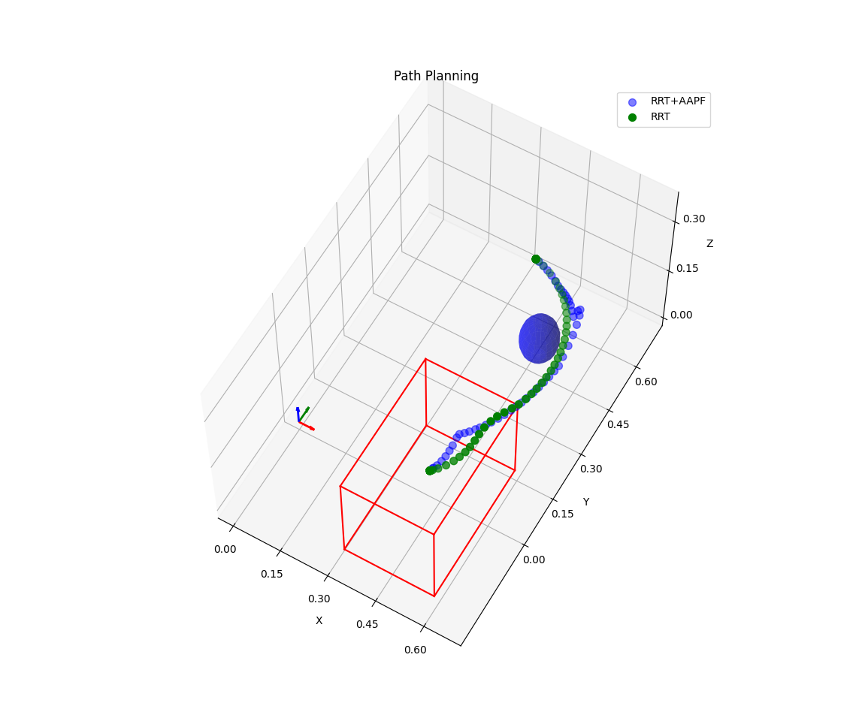
6. RRT and AAPF in Human-collision avoidance
6.3.RRT and AAPF with human scenario:
Robot Trajectory with human hand appearance
Notes:
Results of the reference path and planned path when human wrist are detected in the planning scene

Slide 29
6. RRT and AAPF in Human-collision avoidance
The new path planning in certain scenario:
Can deals with dynamic environment (human).
Avoids local minima by following the reference points.
The new path by APF planner may differ from RRT reference due to distance between the robot and the obstacle.
Time for robot moving is longer than RRT due to robot need to stop at each planned points.
The jerky, shaky trajectory.

Slide 30
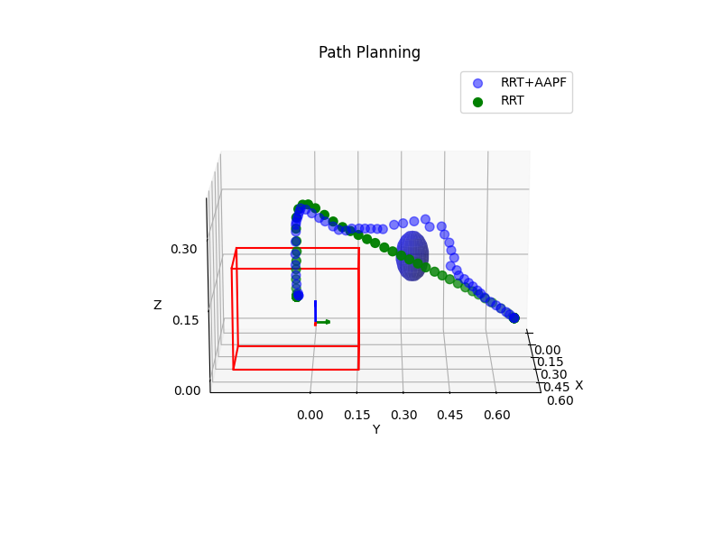
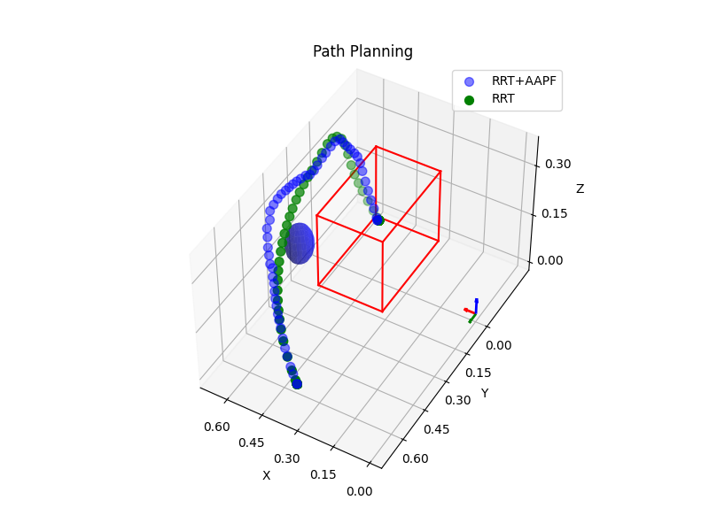
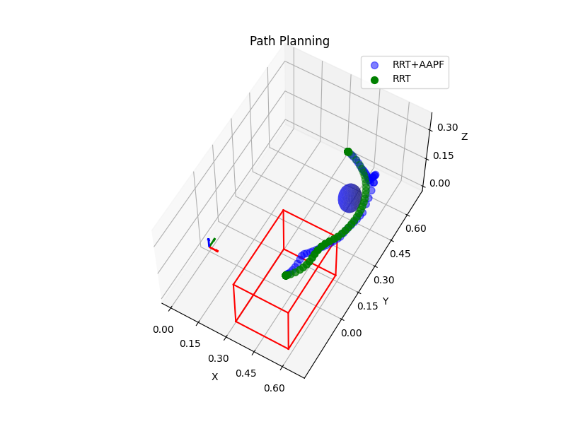
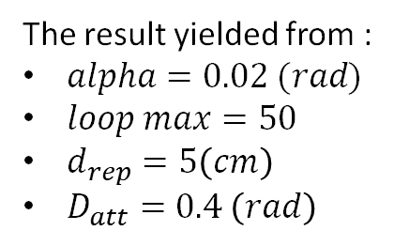
6. RRT and AAPF in Human-collision avoidance
6.4. Parameters Tuning: $K_{att} , K_{rep}$ = (1,1)
The result yielded from :
$alpha=0.02 (rad)$
$loop max=50$
$d_{rep}=5\left(cm\right)$
$D_{att}=0.4 \left(rad\right)$

Slide 31



6. RRT and AAPF in Human-collision avoidance
6.4. Parameters Tuning: $K_{att} , K_{rep}$ = (200,400)
The result yielded from :
$alpha=0.02 (rad)$
$loop max=50$
$d_{rep}=5\left(cm\right)$
$D_{att}=0.4 \left(rad\right)$

Slide 32
6. RRT and AAPF in Human-collision avoidance
6.4. Parameters Tuning: $K_{att} , K_{rep}$ = (500,150)
The result yielded from :
$alpha=0.02 (rad)$
$loop max=50$
$d_{rep}=5\left(cm\right)$
$D_{att}=0.4 \left(rad\right)$

Slide 33
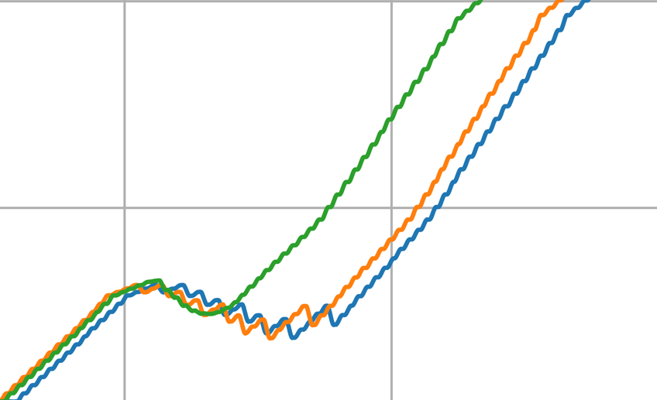



$$\text{6. }\text{RRT} \text{and} \text{AAPF} \text{in} \text{Human}\text{−}\text{collision} \text{avoidance}$$
6.5. Joints trajectory
Experiments with (1,1)
Experiments with (200,400)
Experiments with (500,150)

Slide 34




$$\text{6. }\text{RRT} \text{and} \text{AAPF} \text{in} \text{Human}\text{−}\text{collision} \text{avoidance}$$
6.4. Joints trajectory
Experiments with (1,1)
Experiments with (200,400)
Experiments with (500,150)
Notes:
As we can see, the 3rd pair has proven to have to most consistent joint value by time. The result is a more stable, less spiky and without extreme volatility.

Slide 35

6. RRT and AAPF in Human-collision avoidance
Planning with human hand repulsive field influence
Notes:
Experiment results

Slide 36

6. RRT and AAPF in Human-collision avoidance
Replanning using RRT when collisions are imminent
Notes:
Experiment results

Slide 37


7. Conclusion
Achievements:
Develop a basic human-collision behavior by combining RRT and APF.
Estimate human wrist position ($±5cm$).
Non-Human: +50.28 secs
Static Human: +20.36 secs
Dynamic Human: -30.44 secs
Note:
Max joint velocity = 0.008 rad/s
Notes:
Dynamic human: no rrt replan, and human hand will move before the loop hits 50
Static human: wrist stay put and considered as a static obstacle, RRT replan

Slide 38
7. Conclusion
System Limitation:
The Jerky Trajectory
Time consuming in selecting APF planner’s coefficients.
Not all human joint are considered.
Not responsive.
Future works:
Change the controller from “JointPositionTrajectory” to “JointVelocity”.
Replacing “Gradient Descent” by advanced optimization algorithm for complex constraints.

Slide 39


Our team
Researches and Publications
1. The Development of Robotic Manipulator for Automated Test Tube Arrangement. IEEEICCC2024, Acta Polytechnica Hungarica (Q2).
2. The Development of an Intelligent Robot Arm Playing chess with Human-Robot Interaction. ICHST-2023, IEEE.
Trinh Dam Nhan
K64
Advanced Mechatronics Engineering Program
Nguyen Van Thanh Tri
K65
Mechatronics Engineering Program

Slide 40

THANK YOU !
We would like to express our attitude to Mrs. Mac Thi Thoa for supports and strategies, as well as the colleagues at our laboratory for their support physically and mentally!

